Slide 1

Saturated Absorption Spectroscopy
Anthony Plechacek
Luzando Mukubu

Slide 2
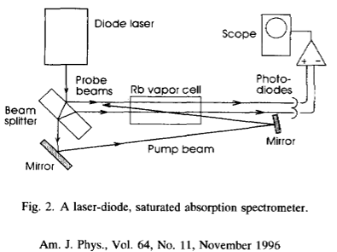
Refresher
Why? Analysis of hyperfine structures of atoms.

Slide 3
Experiment Update
Aligned diffraction grating
Spectrometer
3D printed external cavity diode laser

Slide 4
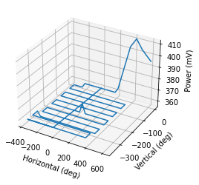
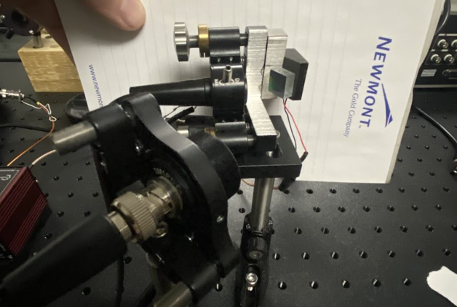
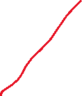
Aligned Diffraction Grating

Slide 5
Tragedy Strikes

Slide 6
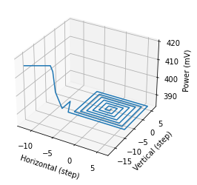
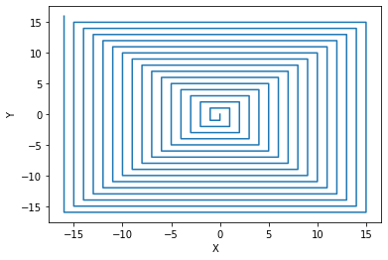
Diffraction Grating: Moving Forward
Tighten Setup
New Pattern

Slide 7
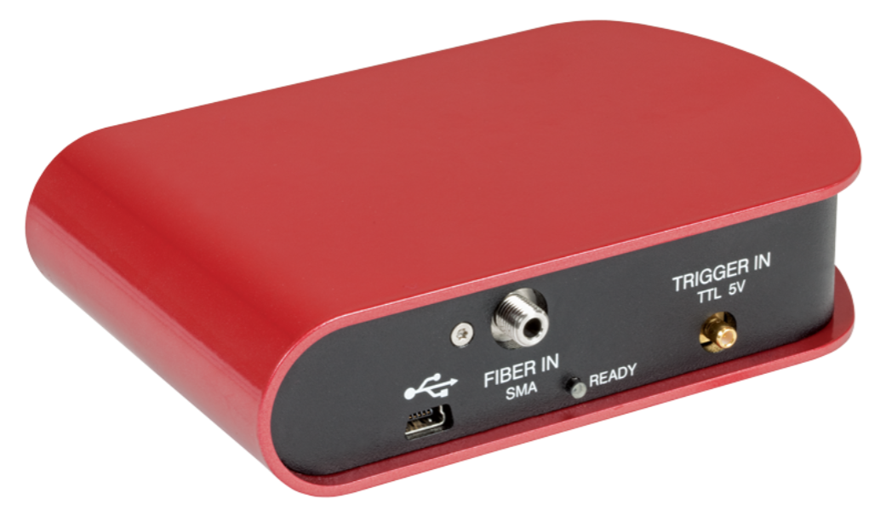
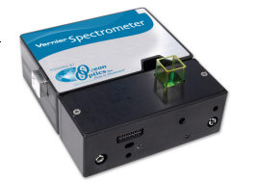
Spectrometer
350 nm - 700 nm

Slide 8
Next Step
Adjust Power input to laser
Cooling laser shift modes

Slide 9
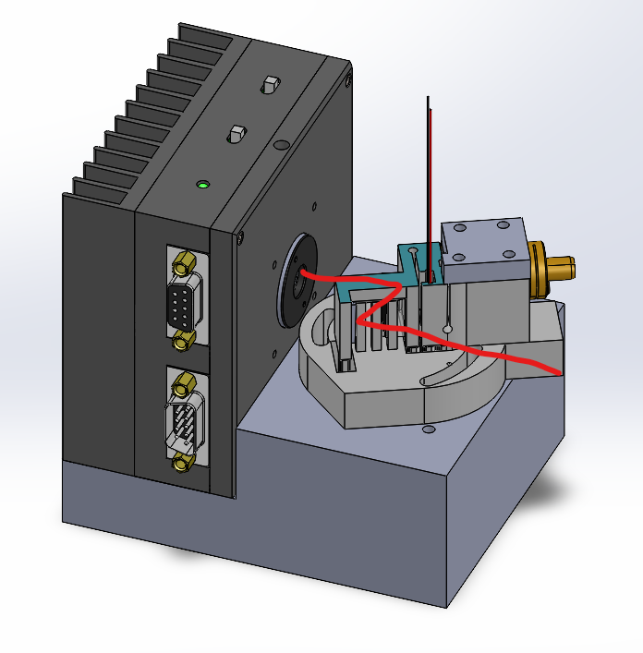
3D Printed External Cavity Diode Laser

Slide 10

Questions

